Slide 1
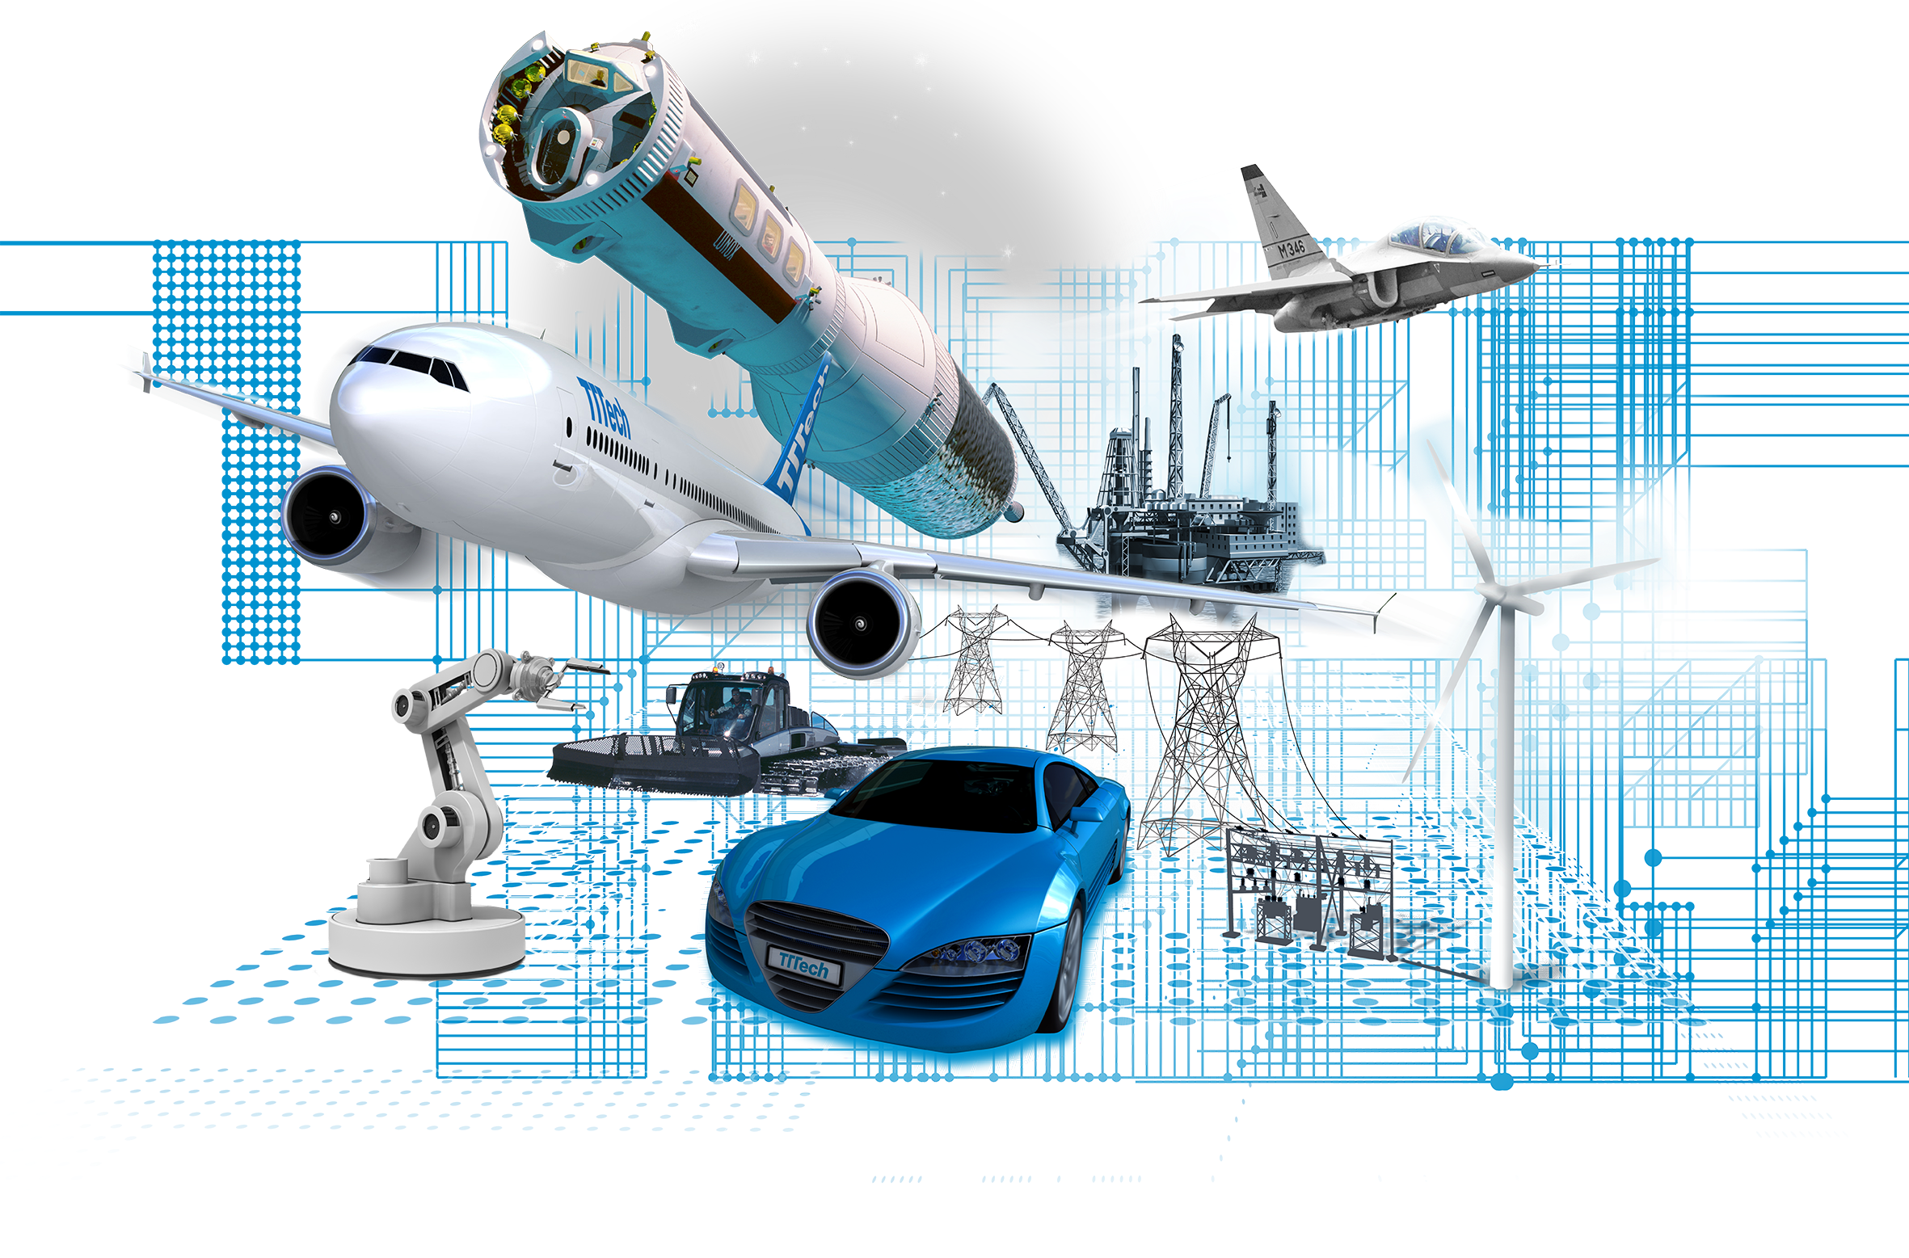

Optimization challenge Configuring autonomous vehicles
Silviu S. Craciunas
Copyright © TTTech Computertechnik AG. All rights reserved.

Slide 2
TTTech Key Facts
TTTech provides highly reliable and networked electronic systems with solutions based on time-triggered networking technology and modular building blocks for safety controllers
Globally oriented high-tech company, headquartered in Vienna, Austria
20 years of innovation leadership – successful transfer of groundbreaking research from TU Vienna to high-volume production
Copyright © TTTech Computertechnik AG. All rights reserved.

Slide 3




































TTTech Group | markests, customers and partners
13
1,700+
COUNTRIES
EMPLOYEES / SUBCONTRACTORS
HQ 3
2
2
1
1
1
1
1
1
1
1
1
AUSTRIA
GERMANY
USA
SERBIA
CZECH REP.
ITALY
CROATIA
BOSNIA
ROMANIA
FINLAND
CHINA
JAPAN
SPAIN
R&D/ENG/ ADMIN
717+
AUTO- MOTIVE
612+
INDUST- RIAL
86+
OFF- HIGHWAY
127+
AERO- SPACE
158+
Copyright © TTTech Computertechnik AG. All rights reserved.

Slide 4
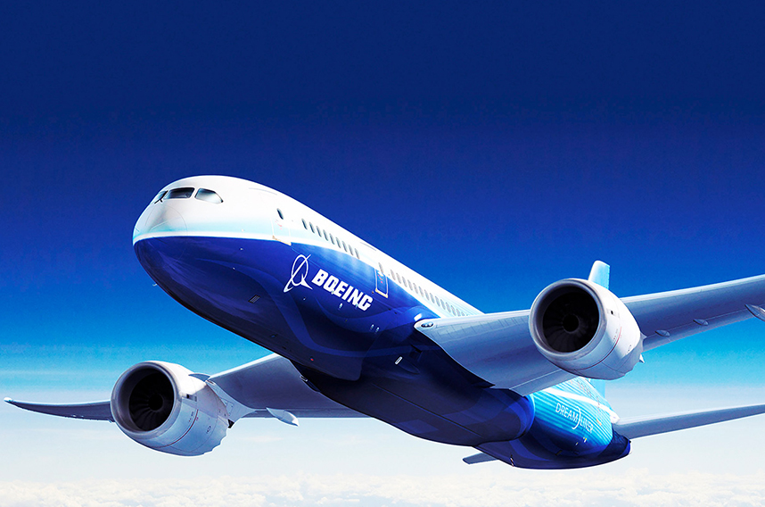
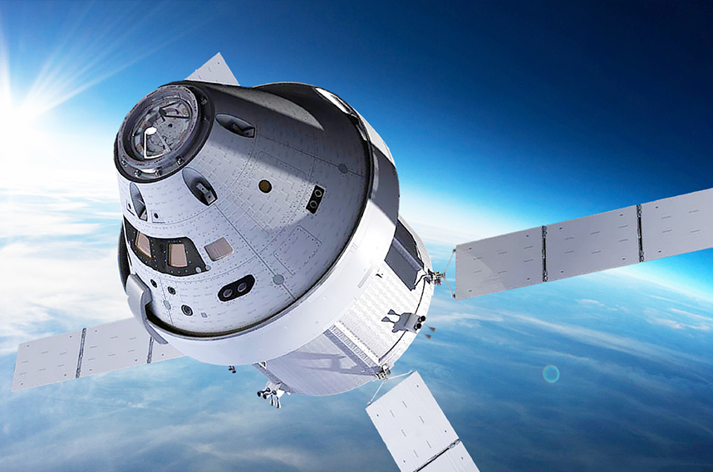

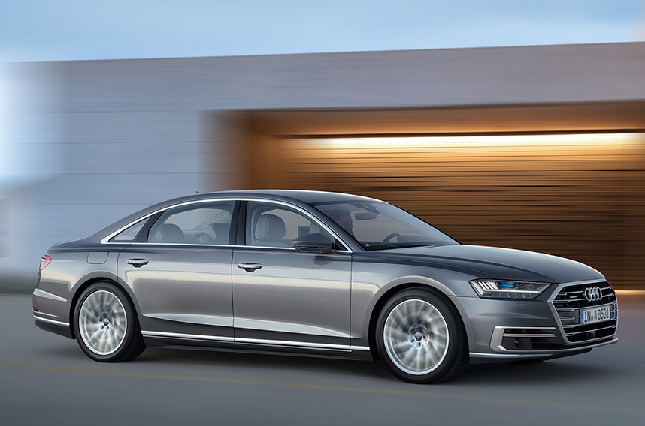

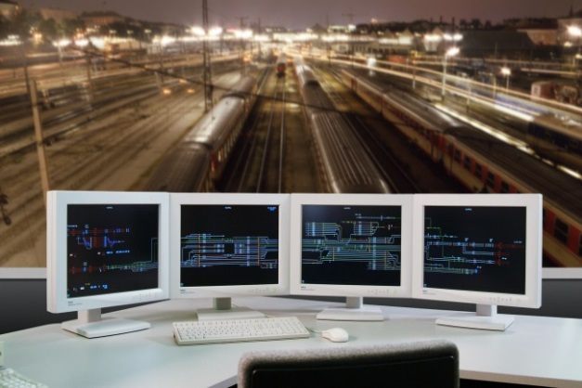
What do these markets have in common?
Reliable networks and safety controls from TTTech
Boeing 787
NASA Orion
Vestas Wind Turbines
Audi Piloted Driving
Prinoth Leitwolf
Thales Railway Signalling
10/4/19
Copyright © TTTech Computertechnik AG. All rights reserved.

Slide 5

R&D Funded Projects at a Value of 20 MEUR
R&D Cooperation with Industry
Universities: Vienna University of Technology, Berkeley University of California, DTU, Chalmers University of Technology, KTH, University of Siegen, University of Kaiserslautern, etc.
Research Organizations: Austrian Institute of Technology, Barcelona Supercomputing Center, CEA, Technalia, Fortiss GmbH, Fraunhofer Society, SRI, TNO, etc.
Aerospace: Airbus, Boeing, Diehl, Honeywell, Liebherr, Safran, Thales, UTC Aerospace Systems etc.
Automotive: Audi, AVL, Continental, Delphi, Denso, Valeo, Volvo, etc.
Industrial: Alstom, IBM, Sysgo, Thales Austria, etc.
Off-Highway: Palfinger, Schwing, etc.
Semiconductors: ams AG, Infineon, Intel, NXP, ON Semiconductor, etc.
International Research Network
EC-funded projects in ARTEMIS, DREAMS, ENABLE-S3, ECSEL, ITEA 1&2, Eurostars, Greencars, Cleansky, Marie Currie and other R&D Projects directly funded in FP5, FP6, FP7, H2020
US programs: NASA, DARPA, NSF
Strategic R&D of time-triggered communication platforms, prototypes for electronic modules, on-board software and safety platform elements for relevant future application domains
Copyright © TTTech Computertechnik AG. All rights reserved.

Slide 6
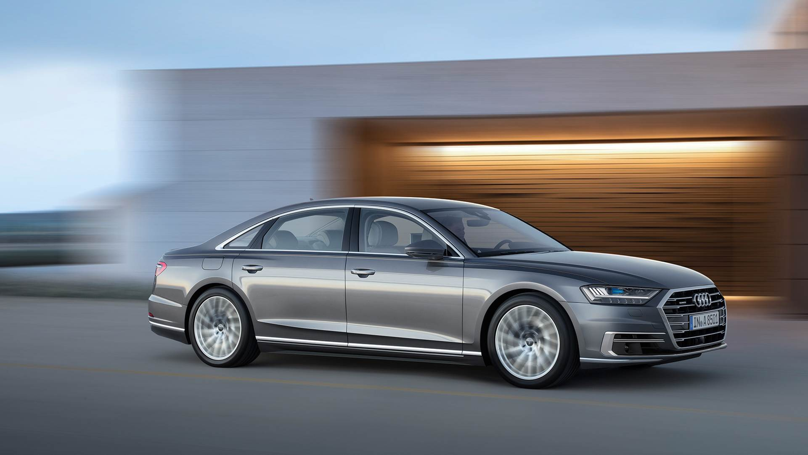

Autonomous vehicles
Increase in Safety – Fewer Accidents
Reduced Emission (The use of electric autonomous taxis alone could reduce greenhouse gas emissions by 90% per mile by the year 2030) – Lower Fuel Consumptions
Better Health – Less Stress Through Traffic Jams – Much Better Predictability
Less Traffic Jams – Increased Highway Capacity

Slide 7





An autonomous vehicle can be understood as a robot
Robot
Sense = See
Think = Compute
Act
Sensors
Brake Actuators
Steering Actuators
Electric Drivetrain
October 4, 2019
Copyright © TTTech Computertechnik AG. All rights reserved.

Slide 8
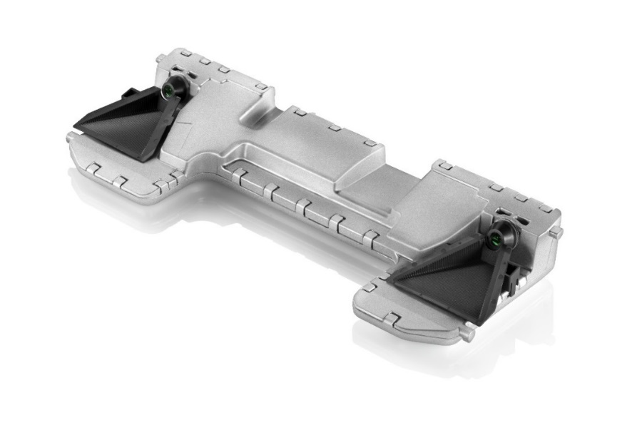
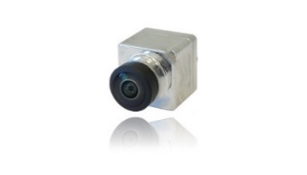

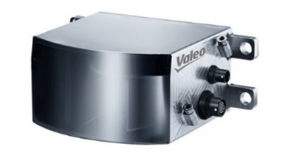
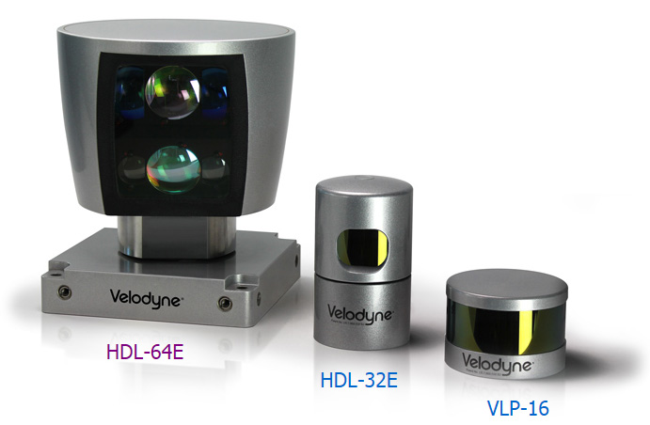
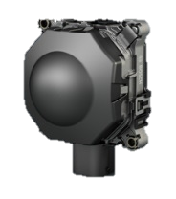
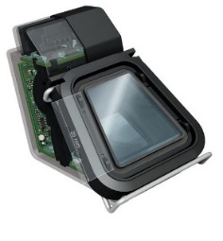
Sensors deployed today
Environment camera
Stereo camera
Ultrasound sensors
Laser scanner
Lidar
Radar
Front camera
October 4, 2019
Copyright © TTTech Computertechnik AG. All rights reserved.

Slide 9
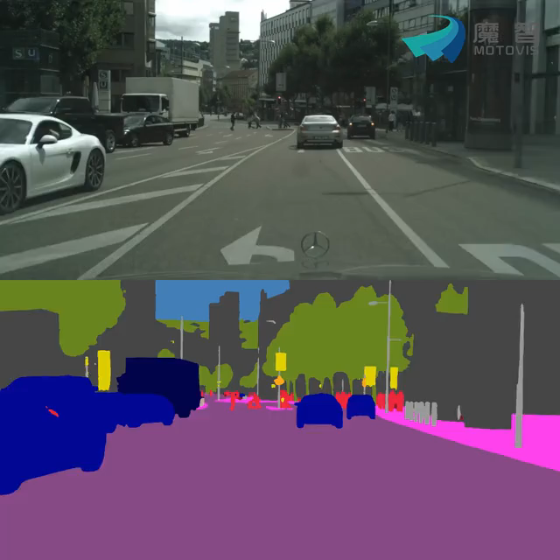
Sensing, computing and actuating
Scene segmentation based on „Deep Learning“ (Neural networks)
Source: Motovis
October 4, 2019
Copyright © TTTech Computertechnik AG. All rights reserved.

Slide 10
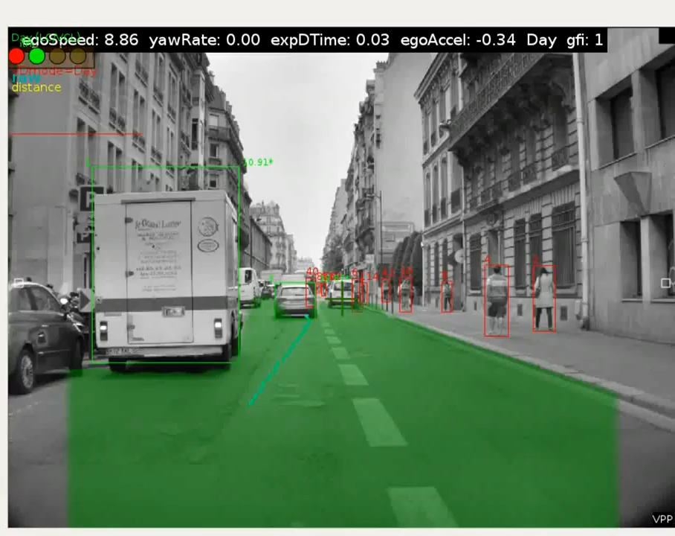
Sensors deployed today
Object recognition
Source: Mobileye
October 4, 2019
Copyright © TTTech Computertechnik AG. All rights reserved.

Slide 11
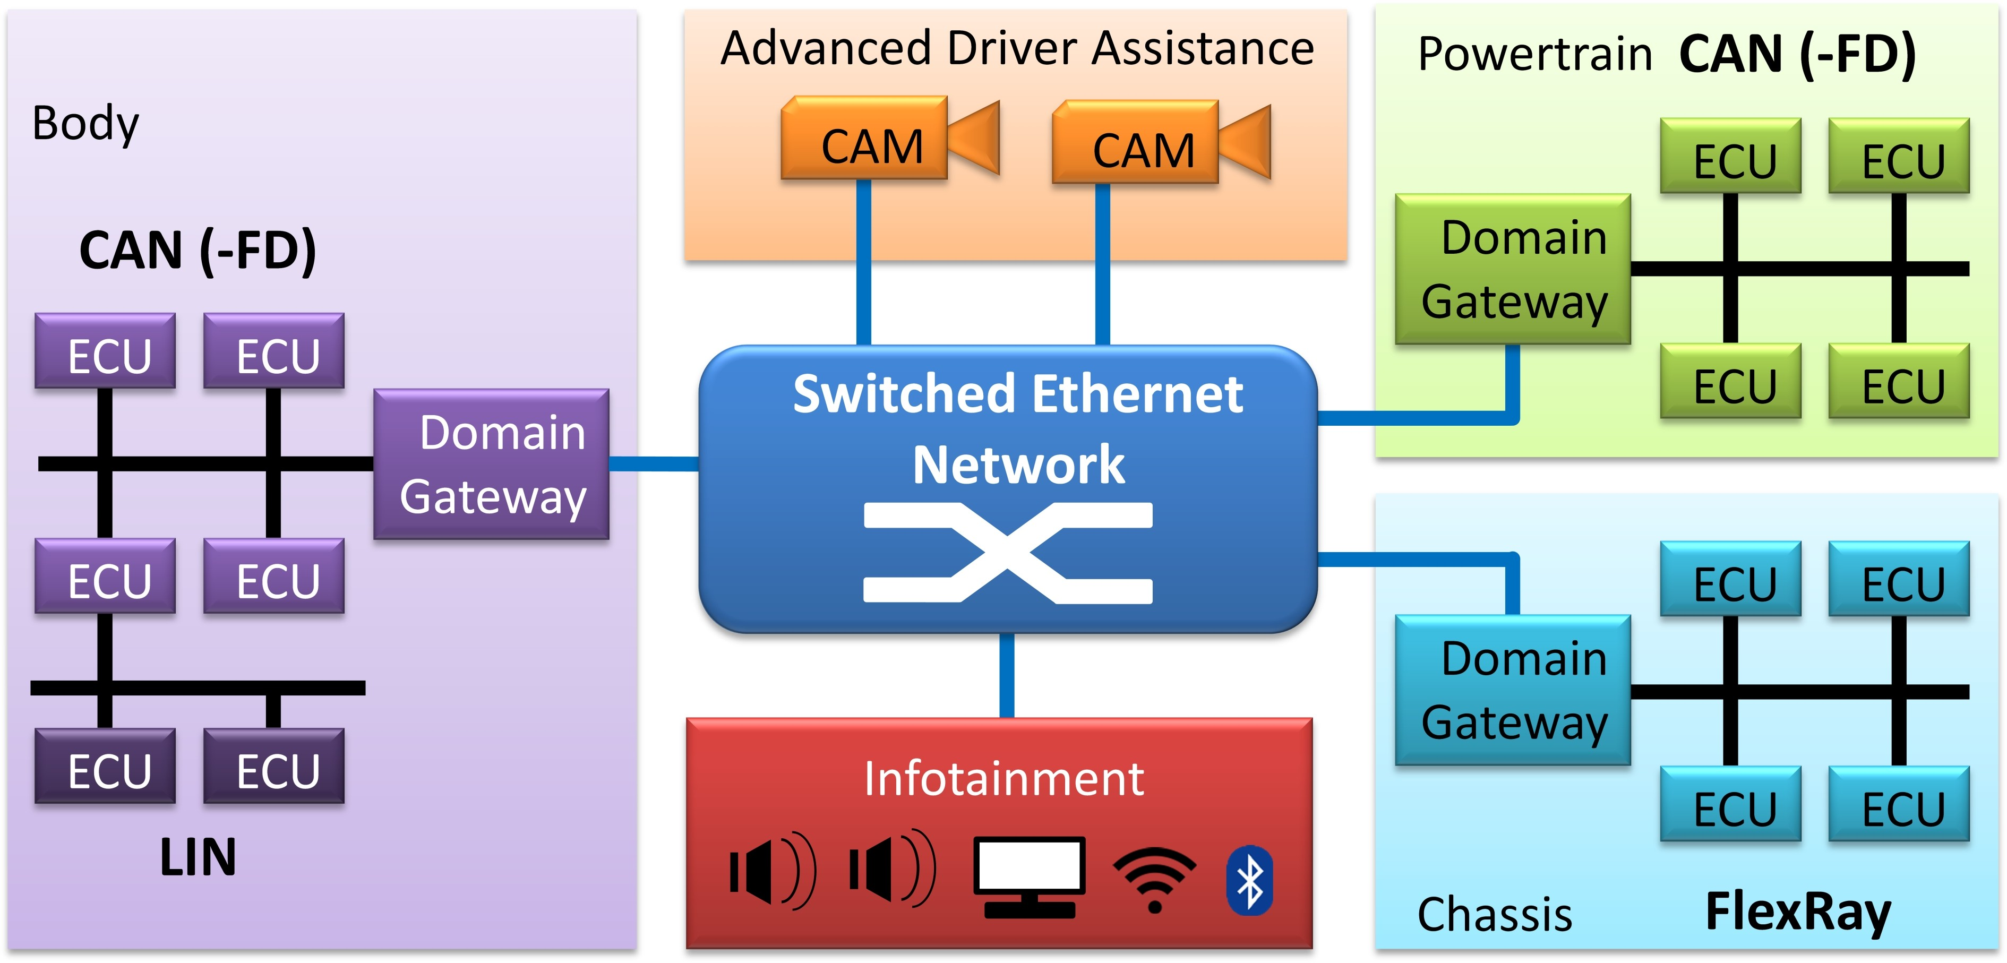
Modern autonomous vehicles
Traditional approach based on distributed ECUs and separated domains, interconnected through different technologies (ETH, CAN, FlexRay)
Source: Ernst et al. - Ethernet as Future Automotive Communication Backbone
October 4, 2019
Copyright © TTTech Computertechnik AG. All rights reserved.

Slide 12
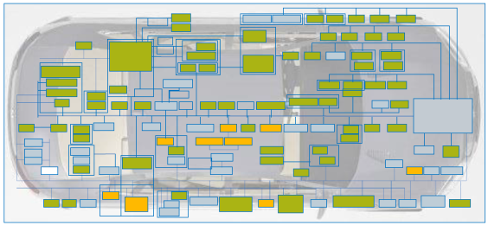
Modern autonomous vehicles – issue I
Rapid growth of software functionality and the necessary compute performance cannot be addressed with current electronics architecture and ECUs
autonomous driving
connectivity
infotainment
electrification & hybrids
new mobility
Too many ECU’s with too little processing power and memory
October 4, 2019
Copyright © TTTech Computertechnik AG. All rights reserved.

Slide 13
Modern autonomous vehicles – issue II
Limitation of the domain concept
N domains imply N times development cost.
N domains imply N times the execution of basic software functions (operating systems, diagnostics, management, etc.)
N domains imply N times sources of software and hardware faults.
N domains imply N times maintenance cost.
October 4, 2019
Copyright © TTTech Computertechnik AG. All rights reserved.

Slide 14
Modern autonomous vehicles – issue III
Fail-operational requirement for level 4 autonomous driving
A failure can occur in an arbitrary complex situation.
Minimum system safety reaction: stop in a safe area or let driver take over – requires > 10 seconds of complex behavior (360 meters at highway speed!).
Redundancy (active / fallback) to cope with HW and SW failures.
Make sensor set available to active and fallback systems.
Provide sufficient computation power also on fallback system.
Avoid simultaneous failure of active and fallback systems at all cost!
The domain concept is not sustainable for L4/L5 autonomous driving.
Autonomous driving functions require the integration of cross-domain information and functions.
E.g., highly precise maps, sensor fusion
October 4, 2019
Copyright © TTTech Computertechnik AG. All rights reserved.

Slide 15
From distributed, separate ECUs …
Copyright © TTTech Computertechnik AG. All rights reserved.

Slide 16
… to a central, integrated platform.
Copyright © TTTech Computertechnik AG. All rights reserved.

Slide 17
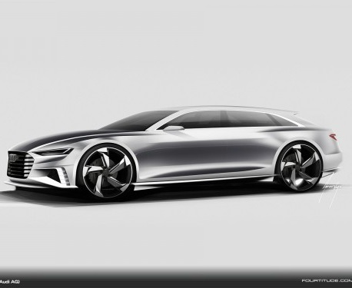


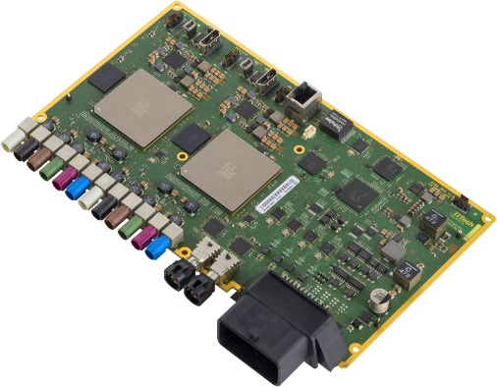

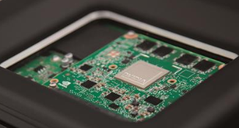

Integrated platform
Gateway
Infotainment
In Car Computing Platform (ICCP):
- from hardware to software
- from distributed to centralized
Autonomous driving
Copyright © TTTech Computertechnik AG. All rights reserved.

Slide 18
Integrated platform
QM
ASIL
Consumer
A
Ap
p
Ap
Ap
App
App
App
pp
p
Ap
App
App
App
App
App
App
App
App
App
App
App
App
OTA updates
cloud services
OTA diagnostics/
data collection
Production resource allocation
Memory
Storage
ICC Network & uplink
Networked I/O
Safety core
Special purpose core (GPU, NPU, etc.)
Performance core
ICCP – Shared HW resources
HW upgrade
Copyright © TTTech Computertechnik AG. All rights reserved.

Slide 19
ICCP – Foundational Technology Principles
Layered distributed computer system: SoC layer, PCB layer, ECU layer, Vehicle layer.
Virtualization on all four layers of all ICCP resources: processors, communication, storage.
Static configuration/scheduling for safety and security.
Dynamic configuration/scheduling for performance, flexibility, maintainability, upgradeability.
Safety first – static trumps dynamic.
Copyright © TTTech Computertechnik AG. All rights reserved.

Slide 20
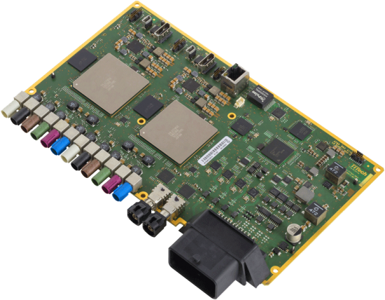
RazorMotion
Processing Resources: 1x Renesas RH850P/1H-C (ASIL D MCU with lockstep cores @ 240MHz) 2x Renesas R-Car H3 (ASIL B SoC with 4x Cortex A57, 4x Cortex A53, 1x Cortex R7, 1x IMP-X5, 1x IMG GX6650 GPU)
Video Interfaces: 12 x camera inputs (GMSL) incl. remote supply (PoC) 2 x display outputs (FPD-Link III)
Communication Interfaces: 4x OABR 100BASE-T1 2 x FlexRay (A/B channel) – wakeup capable 2 x HS-CAN – wakeup capable 4 x CAN-FD 2 x LIN I/O Interfaces 2 x analog/digital inputs 2 x high side outputs 1 x sensor supply output (5V)
Copyright © TTTech Computertechnik AG. All rights reserved.

Slide 21
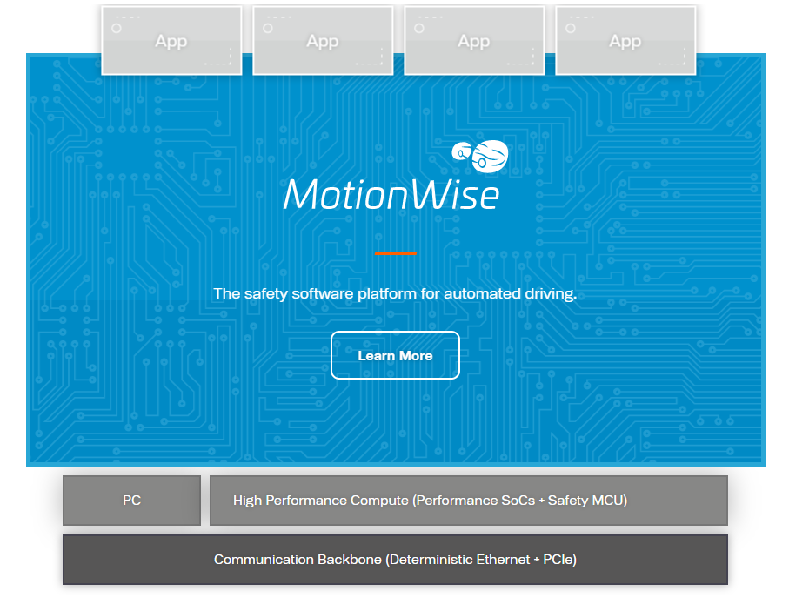
MotionWise
Integrated multi-SOC platform, instead of separate platforms (Classic Autosar, Adaptive Autosar, plain POSIX) for each host
Guaranteed realtime processing (vs. Adaptive Autosar does not have a realtime concept)
Deterministic scheduling and guaranteed end-to-end latency control across heterogeneous SoCs
Integrated automotive services across multi-SoC platform (diagnostics, flashing/update, calibration, …)
Seamless application portability across heterogeneous SoCs
Integrated communication and data framework across heterogeneous SoCs, including persistent storage
Copyright © TTTech Computertechnik AG. All rights reserved.

Slide 22
ICCP Platform
Different multi-core CPUs:
process the information arriving from a variety of sensors (radar, ultrasonic sensors, cameras, LIDAR, etc.)
run control loops
run other utility functions (lane keeping/changing assistant, emergency braking, logging, etc.)
ICCP = Heterogeneous multi-core multi-SoC platform featuring a variety of CPUs and GPUs running at different speeds, which are interconnected through either a deterministic Ethernet backbone (TSN) or through PCIe
Task1
Task2
Task3
Task4
…
Taskn
MiddleWare
Autosar OS
Safety RTOS
Linux
Multi-Core MCU
Safety
Performance/Safety
Performance
CPU
CPU
CPU
CPU
CPU
CPU
CPU
CPU
CPU
CPU
CPU
CPU
GPU
Deterministic Ethernet / PCIe Backbone
Copyright © TTTech Computertechnik AG. All rights reserved.

Slide 23
ICCP platform – software stack
Each host can run a different operating system depending on the safety and performance requirements.
Each such OS can have a different scheduling policy, ranging from fixed-priority (AUTOSAR) to table-driven or dynamic priority scheduling (SafetyRTOS).
On top of this platform a large number of different software functions, implemented by different vendors, must be integrated and deployed.
The system is composed of applications (called tasks or runnables), that are either pre-assigned to cores or must be assigned by the scheduling algorithm.
Tasks have real-time requirements, both in terms of execution (offset, deadline, jitter) as well as temporal dependencies arising from either task chains or communication between tasks.
Copyright © TTTech Computertechnik AG. All rights reserved.

Slide 24
ICCP problem
Function (task) allocation and scheduling problem
The allocation of functions (or even their partitioning) to the layers of ICCP that determines which resources (memory, communication, computation, etc.) are to be assigned to which functions (and at which points in time).
3 types of allocation/scheduling:
fully-static offline (table-driven/time-triggered)
dynamic-offline (i.e. mode change)
dynamic-online
Different dimensions to the allocation problem:
Assignment of tasks to cores/CPUs
Scheduling of tasks in the Guest OS
Communication backbone
NP-complete
Copyright © TTTech Computertechnik AG. All rights reserved.

Slide 25

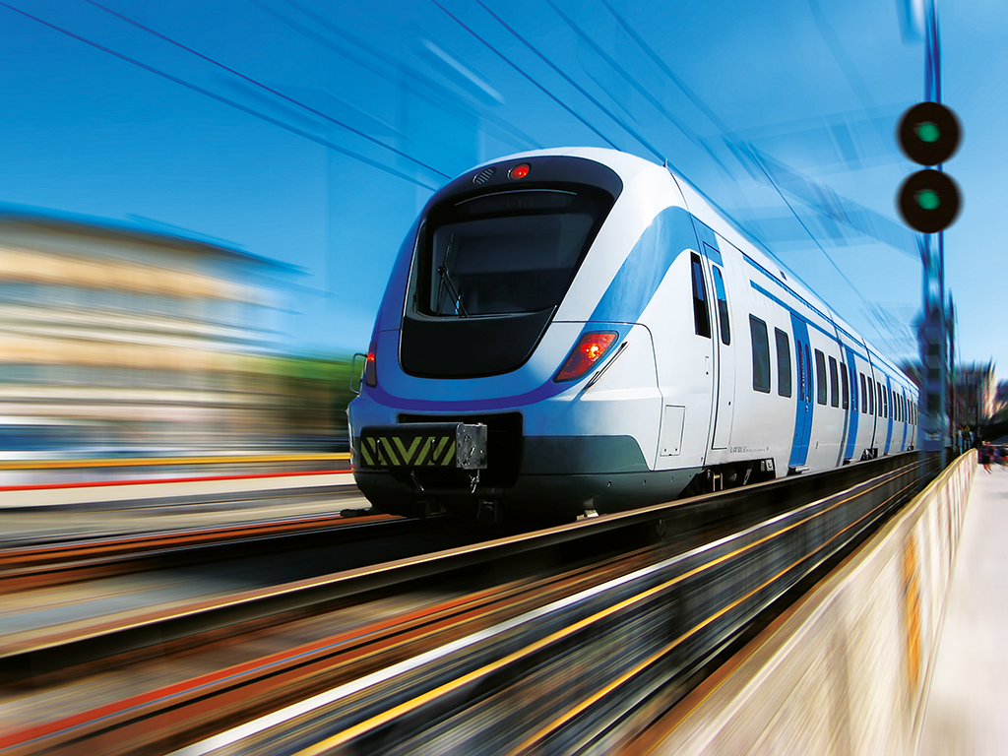
Time-triggered systems
Time-triggered vs. event-triggered systems: transportation example
Taxis are event-triggered: they go whenever they are needed/called - very flexible
Trains are time-triggered: they run according to a fixed schedule – very predictable
Copyright © TTTech Computertechnik AG. All rights reserved.

Slide 26
Deterministic time-triggered design
Event triggered system
Runtime variation in each task
To be adressed by reserving min. 30% system performance
Disadvantages:
Realtime behaviour can not be guaranteed
Additional applications impact overall system behaviour
Benefits:
Realtime behavior guaranteed
Deterministic integration behaviour „composability“
Freedom-from-Interference behavior
Supporting features:
„Remaining time“ to be able to fully load WCET
Smart scheduling mechanisms („Hybrid schedule“)
QM background tasks do not influence critical timing
70%
100%
System Load
Deterministic (time-triggered) system
Runtime variation in each task considered in WCET
System can be loaded to 100%
70%
100%
System Load
October 4, 2019
Copyright © TTTech Computertechnik AG. All rights reserved.
Notes:
Why there is the same amount of apps running on event triggered system as on the TT system – NO of applications??
White parts shooudl be coloured

Slide 27
Preemptive vs. non-preemptive scheduling
Preemptive scheduling allows a running task to be interrupted by another task, whereas in non-preemptive scheduling, the running task hast to complete or voluntarily yield for other tasks to be able to run
deadline miss
0
time
0
time
In static time-triggered scheduling, preemption means that we can split a task in multiple pieces in order to better utilize the timeline
October 4, 2019
Copyright © TTTech Computertechnik AG. All rights reserved.
Notes:
Why there is the same amount of apps running on event triggered system as on the TT system – NO of applications??
White parts shooudl be coloured

Slide 28

Challenge #1

Slide 29
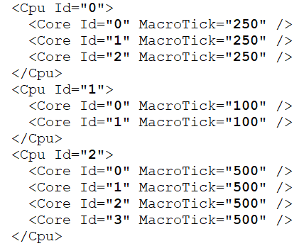
Challenge 1 – function allocation
Platform
m CPUs defined by:
# of cores
speed (cores have the same speed)
macrotick
Table-driven scheduling
Preemption: yes
Migration: no
Copyright © TTTech Computertechnik AG. All rights reserved.

Slide 30
Challenge 1 – microtick vs macrotick
Theoretical timeline is infinitely divisible (Planck time ~ 5.4 × 10⁻⁴⁴ seconds)
Microtick - Ticks generated by the physical oscillator of a clock
Macrotick - Multiple of Microtick chosen by designer of clock/system
0
time
microtick
macrotick
Copyright © TTTech Computertechnik AG. All rights reserved.

Slide 31
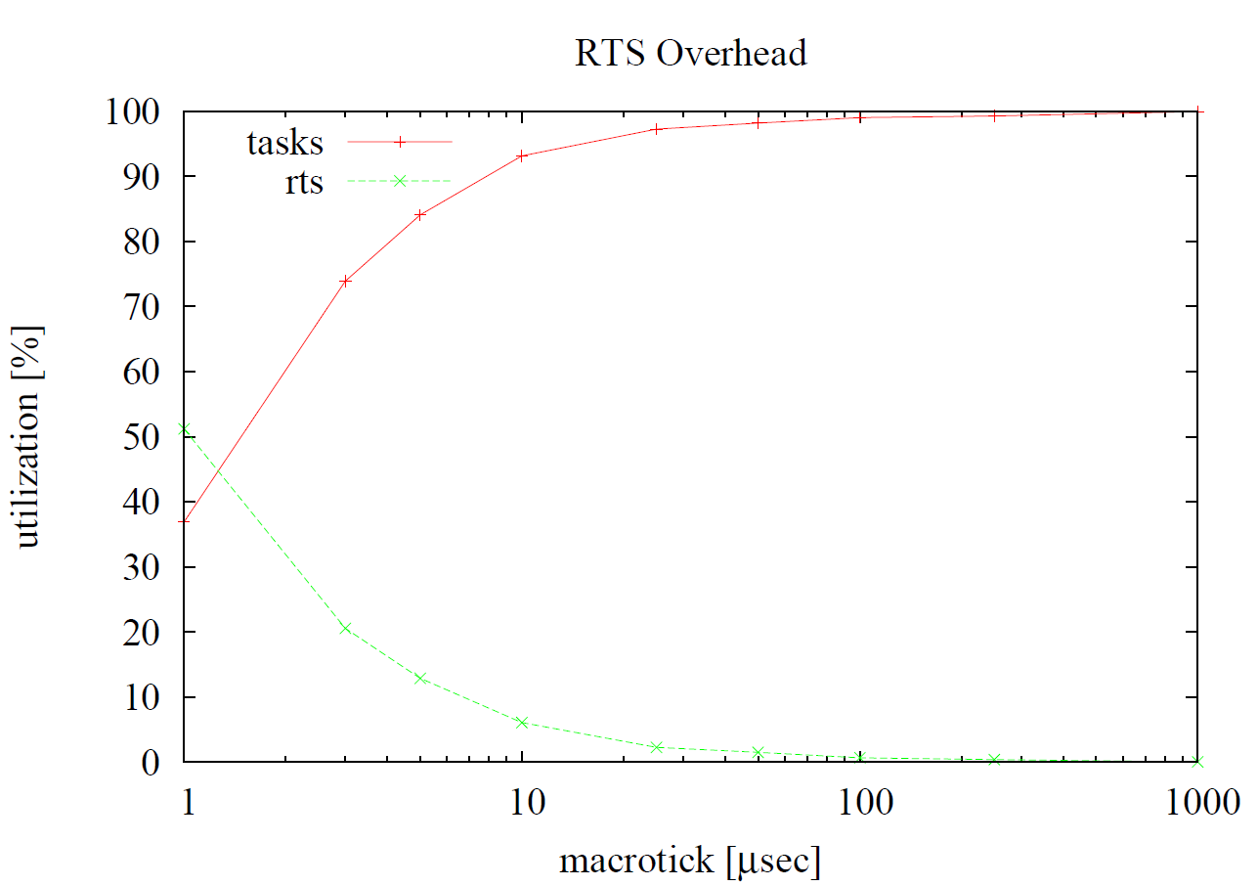
Challenge 1 – macrotick vs system overhead
Trade-off between schedulability and overhead/scheduler runtime
Copyright © TTTech Computertechnik AG. All rights reserved.

Slide 32
Challenge 1 – function allocation
Tasks - n tasks defined by:
Id : Integer
UniqueName : A unique name for the task
BCET : Best Case Execution Time of the task; in microseconds
WCET : Worst Case Execution Time of the task; in microseconds; Execution time of a task is between BCET and WCET
Period : Period of a task in microseconds
Deadline : Deadline of a task in microseconds
EarliestActivation : The earliest activation time of task within its period in microseconds.
MaxJitter : Maximum Jitter in microseconds that the task can have. -1 for no jitter limitations.
Offset : The initial displacement of the task arrival times in microseconds.
DeadlineAdjustment : The deadline limit for an instance of a task in microseconds. The limit can not be greater than (Deadline - EarliestActivation).
CpuId : Id of the assigned CPU. Must be assigned.
CoreId : Id of the assigned Core of the CPU; optional; -1 for no core assignment.
Copyright © TTTech Computertechnik AG. All rights reserved.

Slide 33
Challenge 1 – activation, deadline, period
activation
deadline
WCET
0
period
time
Copyright © TTTech Computertechnik AG. All rights reserved.

Slide 34
Challenge 1 – hyperperiod and preemption
2 out of 4
1 out of 6
0
4
6
8
12
time
Hyperperiod = lcm of all periods
Copyright © TTTech Computertechnik AG. All rights reserved.

Slide 35
Challenge 1 – jitter
0
5
10
WCET
10
15
20
Jitter = Jitter* - WCET
20
25
30
30
35
40
Jitter*
Copyright © TTTech Computertechnik AG. All rights reserved.

Slide 36
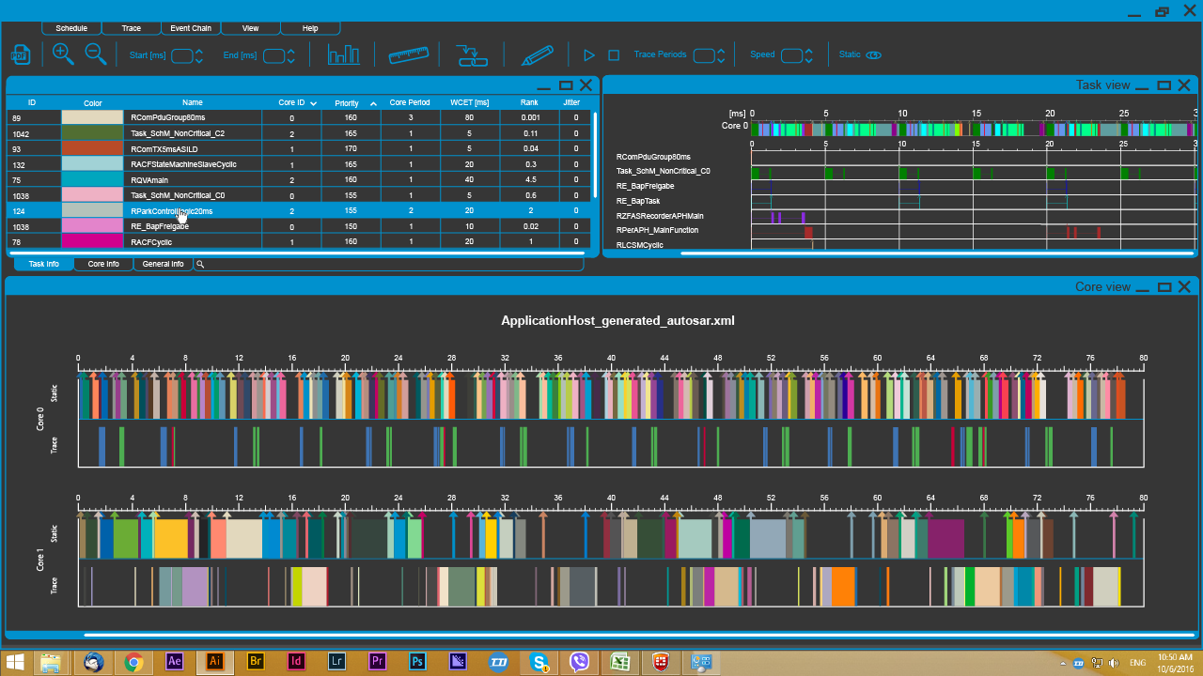
Table-driven static scheduling
Periodic hard real-time tasks with (WCET, Period) definition
Are pre-assigned to CPUs (WCET is already scaled to speed)
Can be pre-assigned to core, if not assigned, assignment will be part of the allocation and scheduling problem
Can have deadline, activation, jitter constraints
Preemption is allowed, migration is not allowed
The result of the scheduling algorithm is an
assignment of tasks to cores and for each core a
static table which determines the exact timely
behavior of assigned tasks
Copyright © TTTech Computertechnik AG. All rights reserved.

Slide 37

Challenge #2

Slide 38
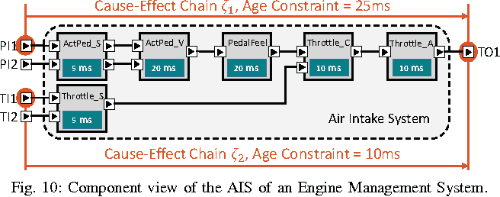
Challenge 2 – adding task dependencies
Characteristic of automotive software – Cause-effect chains:
provide additional timing and dependency requirements on the execution of tasks
can span across multiple activation patterns
include multiple tasks, even the same task multiple times
have priorities and end-to-end latencies
include communication latencies
Source: Becker et al. - Synthesizing Job-Level Dependencies for Automotive Multi-rate Effect Chains
Copyright © TTTech Computertechnik AG. All rights reserved.

Slide 39
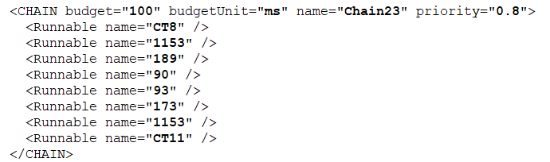
Challenge 2 – adding task dependencies
Scheduling problem:
Schedule tasks such that the chain dependencies are fulfilled (next slide)
Schedule tasks in such a way that all chains are fulfilled in terms of their end-to-end latencies
Optimize such that chains with higher priority have a lower latency than those with lower priority
For now we consider that communication delays are fixed (PCIe)
Copyright © TTTech Computertechnik AG. All rights reserved.

Slide 40
Dependency chains
Latency 2
0
10
20
30
40
τ1
τ2
τ3
τ4
Latency 1
Copyright © TTTech Computertechnik AG. All rights reserved.

Slide 41
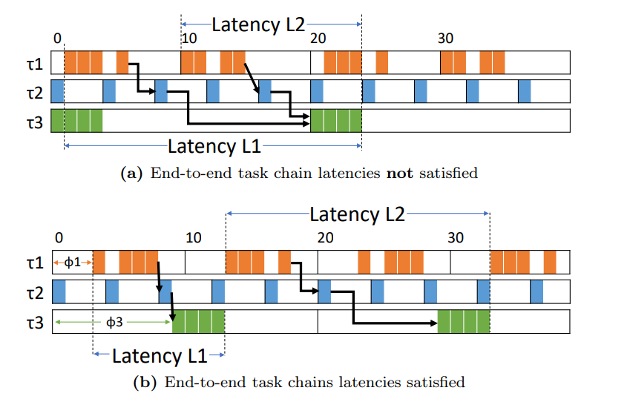
Challenge 2 – adding task dependencies
Copyright © TTTech Computertechnik AG. All rights reserved.

Slide 42
Challenge 1+2 – example approach based on EDF
Copyright © TTTech Computertechnik AG. All rights reserved.

Slide 43
Optimal vs. non-optimal
Optimal scheduler
Looks at entire search space
Finds a solution if there is one (might take a long time)
If no solution is found, no other algorithm can find a solution
Typically NP-complete
Optimal schedule
Search space
Solution space
Near-optimal solution space
Heuristic scheduler
Looks at a fraction of the search space
Not guaranteed to find a solution
Designed to be fast
Tries to find near-optimal solution
Optimal Solution
Copyright © TTTech Computertechnik AG. All rights reserved.

Slide 44
Important scheduling results
Rate-Monotonic [Liu73]
static scheduling algorithm
static priotities are inverse proportional to period lengths
optimal among fixed-priority algorithms (periodic tasks)
sufficient and necessary schedulability condition exist
Earliest-Deadline-First [Liu73]
dynamic scheduling algorithm
at each time instant, the job with the earliest relative deadline is chosen to run
preemptive and non-preemptive variants
optimal and non-optimal results depending on task properties (presented next)
October 4, 2019
Copyright © TTTech Computertechnik AG. All rights reserved.

Slide 45
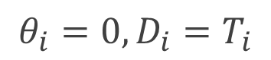
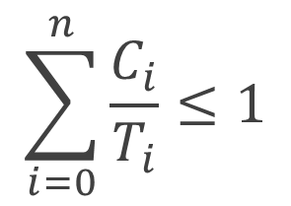
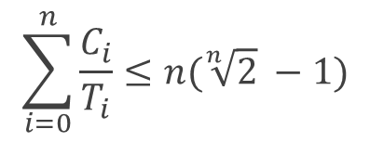
EDF scheduling
Assumption
The task set is schedulable such that all jobs meet their relative deadlines iff
For RM the test is only sufficient and utilization bound is smaller
[Liu73]
October 4, 2019
Copyright © TTTech Computertechnik AG. All rights reserved.

Slide 46
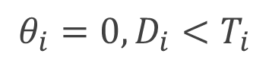
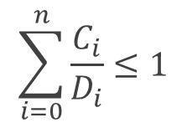
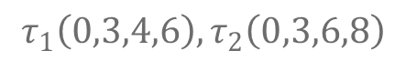
EDF Scheduling
Assumption
Simple approach
only sufficient
$$τ_{1}\left(0,3,4,6\right),τ_{2}\left(0,3,6,8\right)$$
0
4
8
12
16
20
24
0
4
8
12
16
20
24
October 4, 2019
Copyright © TTTech Computertechnik AG. All rights reserved.

Slide 47
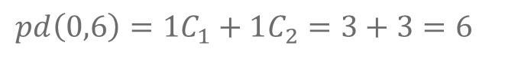
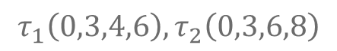
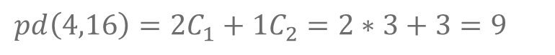
Processor demand
$$τ_{1}\left(0,3,4,6\right),τ_{2}\left(0,3,6,8\right)$$
0
4
8
12
16
20
24
0
4
8
12
16
20
24
$$pd\left(0,6\right)=1C_{1}+1C_{2}=3+3=6$$
$$pd\left(4,16\right)=2C_{1}+1C_{2}=2∗3+3=9$$
October 4, 2019
Copyright © TTTech Computertechnik AG. All rights reserved.

Slide 48
EDF simulation
We can use the necessary and sufficient schedulability test based on dbf
We can use it to generate a static schedule table – simulate EDF until 2*Hyperperiod + max_offset
Schedulability test:
Two knobs to play around with: offset and deadline of each task
Copyright © TTTech Computertechnik AG. All rights reserved.

Slide 49
Simulated Annealing + EDF simulation
Simple Algorithm:
Generate initial candidate:
task offsets = 0
task deadlines = Period
task to core assignment based on best-fit/first-fit
Simulated Annealing Loop:
EDF schedulability test/EDF simulator
Build dependency graph (next slide)
Chain latency test (linear)
Generate neighbor: modification of offsets/deadlines (what is a good metric?)
Copyright © TTTech Computertechnik AG. All rights reserved.

Slide 50
Checking task chains
Open questions/things to improve:
Good metrics (task assignment)
Can we cover the whole solution space with a subset of offset/deadline assignments?
Do we need multiple offsets per task?
Can we encode jitter requirements?
Better GenerateNeighbour function?
Scalability?
Copyright © TTTech Computertechnik AG. All rights reserved.

Slide 51

Challenge #3

Slide 52
Challenge 3 – adding the network layer
Can be solved as an individual challenge (TSN network scheduling)
Copyright © TTTech Computertechnik AG. All rights reserved.

Slide 53

Technology: TTEthernet / TSN
Task1
Task2
Task3
Task4
…
Taskn
MiddleWare
Autosar OS
Safety RTOS
Linux
Multi-Core MCU
Safety
Performance/Safety
Performance
CPU
CPU
CPU
CPU
CPU
CPU
CPU
CPU
CPU
CPU
CPU
CPU
GPU
Deterministic Ethernet / PCIe Backbone
Copyright © TTTech Computertechnik AG. All rights reserved.

Slide 54
Experiment
4
0
2
1
2
0
1
3
4
3
T=
5
lea
sam
bob
mike
1s
michelle
tim
alice
ana
maximum latency = 4s
Copyright © TTTech Computertechnik AG. All rights reserved.

Slide 55


Priority switch
Priority 8
Priority 7
Port A (ingress)
Switching fabric
Priority filter
Priority 6
Port C (egress)
Port B (ingress)
Priority 1
Copyright © TTTech Computertechnik AG. All rights reserved.

Slide 56
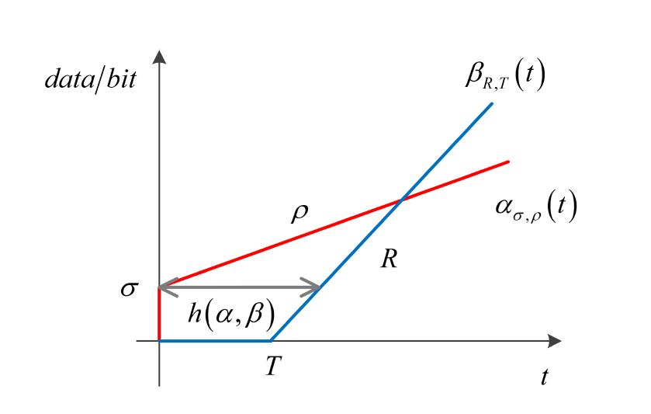
Priority (AFDX) approach
Assign priorities to messages
Latency analysis
Latencies are not fulfilled
Add or change messages
YES
Result
NO
Copyright © TTTech Computertechnik AG. All rights reserved.

Slide 57




The TSN/TTEthernet alternative
Sending and receiving of frames is done according to a global schedule.
0
time
Correct by design (schedule construction)
Compositional (adding flows can be done incrementally)
Minimal jitter and delay bounds
Devices must have a common understanding of time.
Copyright © TTTech Computertechnik AG. All rights reserved.

Slide 58



Network view
Time-triggered communication & timing checks in a network with forwarding: global schedules & delays apply
I will accept only between 9 and 11 ms
I will expect the message between 13 and 15 ms
I will forward at 14 ms
I will transmit at time 10 ms
I will forward at 12 ms
I will accept only between 11 and 13 ms
…switch
…end system
October 4, 2019
Copyright © TTTech Computertechnik AG. All rights reserved.

Slide 59
TTEthernet switch
Priority 8
+
Priority 7
Port A (ingress)
Switching fabric
Buffer
Priority 6
Port C (egress)
Port B (ingress)
Priority 1
Copyright © TTTech Computertechnik AG. All rights reserved.

Slide 60
TSN (Qbv) switch
Priority 8
+
Priority 7
Port A (ingress)
t=0 occoccoc
t=1 oocooccc
t=5 cccccccco
t=7 ococcccc
……
Switching fabric
Priority filter
Priority 6
Port C (egress)
Port B (ingress)
Gate Control List
Priority 1
Copyright © TTTech Computertechnik AG. All rights reserved.

Slide 61
TSN (Qbv) switch
Priority 8
+
Port A (ingress)
Priority 7
Switching fabric
Priority filter
Priority 6
Port C (egress)
Port B (ingress)
Priority 1
0
T=
5
3
1
2
4
Copyright © TTTech Computertechnik AG. All rights reserved.

Slide 62
TSN IEEE 802.1 sub-standards overview
IEEE 802.1Qbv
Scheduled Traffic
IEEE 802.1AS
Time Synchronization
IEEE 802.1CB
Seamless Redundancy
Provides guaranteed communication latency for time-critical traffic over standard Ethernet even in a converged infrastructure.
Profile of IEEE 1588v2 for synchronization of clocks in the network. Supports timing requirements for scheduled TSN networks.
Allows for optimal bandwidth utilization of non-scheduled background traffic sent in parallel with scheduled traffic.
IEEE 802.1Qcc
SRP Enhancements
IEEE 802.1Qbu
Frame Preemption
IEEE 802.1Qci
Filtering and Policing
Defines the interfaces for configuration (distributed and centralized) of TSN networks. Supports configuration models for dynamic scheduling of TSN.
Allows for optimal bandwidth utilization of non-scheduled background traffic sent in parallel with scheduled traffic.
Protects against faulty and/or malicious endpoints and switches. Isolates faults to specific regions in the network.
IEEE 802.1Qca
Path Control and Reservation
IEEE 802.1Qch
Cyclic Queuing and Forwarding
IEEE 802.1Qcr
Asynchronous Traffic Shaping
Protects against faulty and/or malicious endpoints and switches. Isolates faults to specific regions in the network.
Defines cycles for forwarding queued traffic using 802.1Qci to assign buffers and 802.1Qbv to shape traffic.
Provides bounded latency and jitter (lower performance levels) without time-synchronization.
IEEE 802.1Qcp
YANG Model for Bridging
IEEE 802.1Qcw
YANG Model for Qbv, Qbu, Qci
IEEE 802.1CBcv
YANG Model for CB
Enables communication of basic bridging configuration data between bridges in combination with NETCONF
Extends capabilities of 802.1Qcp to communication of scheduling, preemption and policing configuration date between bridges in combination with NETCONF
Extends capabilities of 802.1Qcp to communication of redundancy configuration date between bridges in combination with NETCONF
Copyright © TTTech Computertechnik AG. All rights reserved.

Slide 63
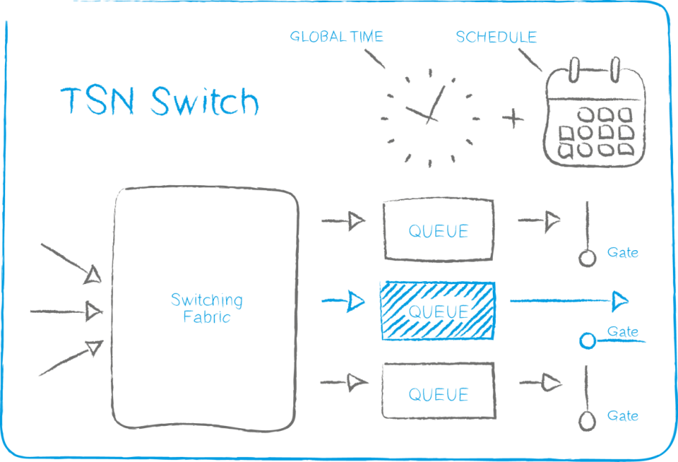

What is a Time-Sensitive Network (TSN)
Time Sensitive Networking covers a set of Ethernet sub-standards currently defined in the IEEE 802.1 TSN task group
At the heart of TSN are mechanisms that provide time synchronization for networked devices and scheduled forwarding of defined traffic flows through the network.
Through time synchronization and scheduling, TSN delivers deterministic communication over standard Ethernet, thereby enabling the convergence of critical control traffic with data traffic over one infrastructure without the need for gateways or proprietary solutions.
Copyright © TTTech Computertechnik AG. All rights reserved.

Slide 64
Time-Sensitive Network (TSN)
IEEE TSN task group - collection of sub-standards that enhance 802 Ethernet with real-time capabilities
Standard | Description
802.1ASrev | Timing & Synchronization
802.1Qbv | Enhancements for Scheduled Traffic (Timed Gates for Egress Queues)
802.1Qbu | Frame Preemption
802.1Qca | Path Control and Reservation
802.1Qcc | Central Configuration Management
802.1Qci | Per-Stream Time-based Ingress Filtering and Policing
802.1CB | Redundancy, Frame Replication & Elimination
Copyright © TTTech Computertechnik AG. All rights reserved.

Slide 65
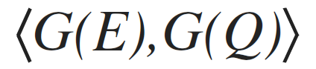
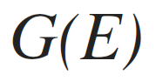
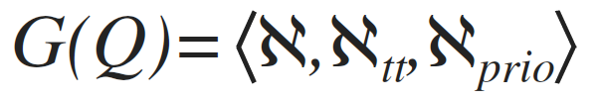
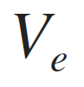

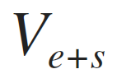
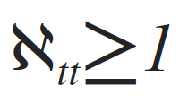
Functional parameters
Device capabilities
Queue configuration
Scheduled Es
Scheduled Sw
Scheduled Es+Sw
Critical traffic assigned to the scheduled queues
Non-critical traffic assigned to priority queues (post-analysis through network calculus [Frances@ERTS06])
Isolation: non-critical streams may interfere with each other in priority queues, but not with critical streams (isolated in the scheduled queues)
Copyright © TTTech Computertechnik AG. All rights reserved.

Slide 66

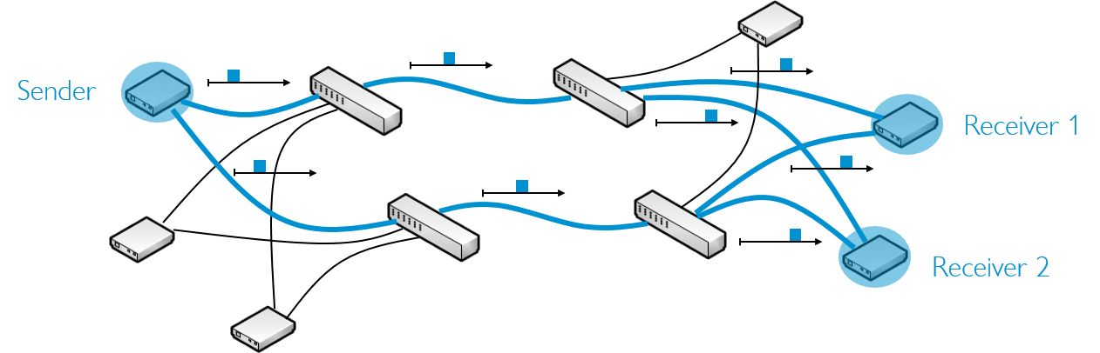
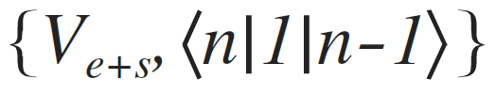

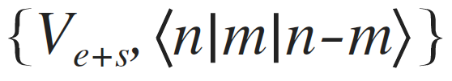
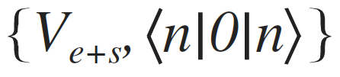
802.1Qbv configurations
Only critical traffic (serialized similar to bus systems)
Legacy AVB systems that require a few additional high-criticality flows [Specht@ECRTS16]
Maximize solution space for critical traffic, non-critical traffic can be scheduled by inverting the cumulated schedule of scheduled queues
High-criticality applications that feature both scheduled and non-scheduled traffic, trade-off between schedulability of critical traffic and timeliness properties and flexibility for non-scheduled traffic
Standard AVB (IEEE 802.1BA) network in which flows are serviced according to the priority
Copyright © TTTech Computertechnik AG. All rights reserved.

Slide 67
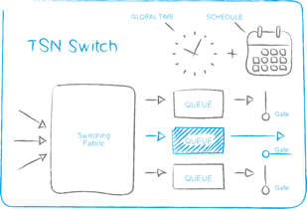
Network and traffic model
multi-hop layer 2 switched network via full-duplex multi-speed links
(multicast) TSN streams with multiple frames per stream
communication is from one sender to one or multiple receivers
synchronised time (<1 usec precision)
wire and device delays
Scheduled 802.1Qbv-compatible devices (Sw + Es)
Scheduled (mutually exclusive) & priority queues
Guaranteed delivery of critical traffic with known latency, small & bounded jitter
Copyright © TTTech Computertechnik AG. All rights reserved.

Slide 68

TSN schedule
The TSN (Qbv) schedule defines open and close events for the Gate Control List (GCL) in each output port of every TSN device in the network
The schedule is build off-line taking into account the maximum end-to-end latency, frame length, as well as constraints derived from resources and physical limitations.
The schedule must enforce a deterministic behaviour of frame transmission and reception
Sender
Receiver 1
Receiver 2
TSN Switch
Offline scheduling
TSN End System
October 4, 2019
Copyright © TTTech Computertechnik AG. All rights reserved.

Slide 69

TSN schedule synthesis
Scheduling for TSN therefore means:
Find transmit (and implicitly receive) times and queue assignment for all frames on all devices such that
No collisions on ports occur
Frames are sent correctly in the time domain
End-to-end latencies are fulfilled
Other user-defined constraints are fulfilled
Etc.
Schedule correctness conditions
Technology
Communication
User-defined
Copyright © TTTech Computertechnik AG. All rights reserved.

Slide 70

Correctness conditions
Frame placement within period
period
0
time
frame size
release
deadline
0
time
Copyright © TTTech Computertechnik AG. All rights reserved.

Slide 71
Correctness conditions
Frames are not allowed to overlap in the time domain
period = 4
period = 6
0
time
Hyperperiod = 12
Copyright © TTTech Computertechnik AG. All rights reserved.

Slide 72
Correctness conditions
Frames are not allowed to overlap in the time domain
period = 4
period = 6
For all frames scheduled on the same link
check overlapping in any period instance
until hyperperiod of the two considered periods
0
time
Hyperperiod = 12
Copyright © TTTech Computertechnik AG. All rights reserved.

Slide 73
Virtual link constraints
A frame must be received before it is forwarded
Device i
0
time
Device i+1
0
time
δtransmission
δforwarding
δtransmission = Wire Delay + Port delays + Transmission delay + Precision
δforwarding = Switch forwarding delay
Copyright © TTTech Computertechnik AG. All rights reserved.

Slide 74


Correctness conditions
Memory buffer constraints
Device i
0
time
Maximum allowed time for frame to be stored in switch buffer
Copyright © TTTech Computertechnik AG. All rights reserved.

Slide 75
Correctness conditions
Maximum end-to-end latency constraint
Sender
0
time
Switch 1
0
time
Switch 2
0
time
Receiver
0
time
End-to-End Latency
Copyright © TTTech Computertechnik AG. All rights reserved.

Slide 76
User constraints
Scheduling constraints are additional conditions on the correctness of the schedule.
Start time constraint
End time constraint
End-to-end latency constraint
Transmission gap constraint
Precedence constraint
Floating window constraint
Best-effort reservation constraint
October 4, 2019
Copyright © TTTech Computertechnik AG. All rights reserved.

Slide 77
Transmission Gap Constraint
Enforce a gap between the reception of one flow and the transmission of another
Switch
0
time
Receiver
0
time
Switch
0
time
Transmission Gap
October 4, 2019
Copyright © TTTech Computertechnik AG. All rights reserved.

Slide 78
Queue interleaving
In order to maintain jitter and latency requirements we expect at each device a certain timely order of frames
Copyright © TTTech Computertechnik AG. All rights reserved.

Slide 79
Queue Interleaving
expected
synchronization errors, frame loss, time-based ingress policing (e.g. IEEE 802.1Qci) may lead to non-deterministic placement in queues during runtime
timed gates control events on the egress port, not the order of frames in the queue
placing of frames in the scheduled queues at runtime may be non-deterministic
Timely behaviour of streams may oscillate, accumulating jitter for the overall end-to-end transmission
Copyright © TTTech Computertechnik AG. All rights reserved.

Slide 80
Queue Isolation
expected
Solves the non-determinism problem but reduces the solution space
Copyright © TTTech Computertechnik AG. All rights reserved.

Slide 81
Stream (Flow) Isolation
expected
Once a flow has arrived, no other flow can arrive in the same queue until the first flow has been completely sent
Better than queue isolation but still restrictive
0
t1
t1
t1
0
t2
Copyright © TTTech Computertechnik AG. All rights reserved.

Slide 82
Frame Isolation
expected
Ensure that there are only frames of one flow in the queue at a time
Frames from another flow may only enter the queue if the already queued frames of the initial flow have been serviced
Less performant than stream isolation since the solver has to consider at all frame interleavings
Copyright © TTTech Computertechnik AG. All rights reserved.

Slide 83
802.1Qbv scheduling constraint
The constraint for minimum jitter scheduling of critical traffic for 802.1Qbv networks is:
isolate frames/streams in the time domain
OR
isolate streams in different queues
Copyright © TTTech Computertechnik AG. All rights reserved.

Slide 84
Scheduling problem
find routes, offsets and queue assignment for individual frames of
TSN streams from sender to receiver(s) that conforms to the constraints
frame constraints
link constraints
stream constraints
end-to-end latency constraints
stream or frame isolation
802.1Qbv
NP-complete
Copyright © TTTech Computertechnik AG. All rights reserved.

Slide 85

TSN correctness constraints
Silviu S. Craciunas, Ramon Serna Oliver, Martin Chmelik, and Wilfried Steiner Scheduling Real-Time Communication in IEEE 802.1Qbv Time Sensitive Networks In Proc. 24th International Conference on Real-Time Networks and Systems (RTNS), 2016.
http://www.cs.uni-salzburg.at/~scraciunas/pdf/conferences/craciunas_rtns16.pdf
Copyright © TTTech Computertechnik AG. All rights reserved.

Slide 86
We have seen what constitutes a correct schedule.
The question is now, how do we generate such a correct schedule?
How complex is the schedule generation? Can we do it efficently?
October 4, 2019
Copyright © TTTech Computertechnik AG. All rights reserved.

Slide 87




SMT/OMT-based scheduling
satisfiability of logical formulas in first-order formulation
Satisfiability Modulo Theories
background theories
variables
logical symbols
non-logical symbols
quantifiers
optimization criteria: Optimization Modulo Theories [Bjørner@TACAS15]
Formalization of technology, communication and user constraints
Optimal scheduler
Feasible/Optimal schedule
Easily extendable for new constraints
A lot of solvers and a very active community
Yices [Dutertre@CAV14]
Z3 [de Moura@TACAS08]
CVC4 [Barrett@CAV11]
OpenSMT [Bruttomesso@TACAS10]
Copyright © TTTech Computertechnik AG. All rights reserved.

Slide 88

Optimization
Optimize schedule with respect to certain properties
of the system (e.g. minimize end-to-end latency of
selected streams)
802.1Qbv-specific optimizations:
QoS properties: minimize required scheduled queues in order to increase QoS properties of non-critical traffic
Design space exploration in case of infeasible use-cases, i.e. find the minimal number of queues required for scheduled traffic such that a schedule is found
Many more optimization opportunities in combination with other TSN sub-standards (e.g. frame preemption)
Copyright © TTTech Computertechnik AG. All rights reserved.

Slide 89
Evaluation
time
hyperperiod
link/CPU utilization
topology
?
periods
macrotick
size of network
Copyright © TTTech Computertechnik AG. All rights reserved.

Slide 90

Experiments
Z3 v4.4.1 solver (64bit) (Yices v2.4.2 with quantifier-free linear integer arithmetic)
64bit 4-core 3.40GHz Intel Core-i7 PC with 4GB memory
3 predefined topologies ranging from 3 end-systems connected to one switch to 7 end-systems connected through 5 switches via 1Gbit/s links with a 1usec macrotick granularity (generate high utilization on the links)
Time-out value for a run to 5 hours
System configuration:
Scalability and schedulability experiments
Copyright © TTTech Computertechnik AG. All rights reserved.

Slide 91
Scalability experiments
Frame isolation method (using an incremental backtracking algorithm with step size of 1)
Vary the problem set in 3 dimensions:
topology size,
number of flows,
flow periods (chosen randomly from 3 sets of predefined periods)
Data size uniformly between 2 and 8 MTU-sized frames
Senders and receivers are chosen randomly
Copyright © TTTech Computertechnik AG. All rights reserved.

Slide 92

Scalability experiments
Copyright © TTTech Computertechnik AG. All rights reserved.

Slide 93

Scalability experiments
Copyright © TTTech Computertechnik AG. All rights reserved.

Slide 94

Scalability experiments
Copyright © TTTech Computertechnik AG. All rights reserved.

Slide 95

Frame vs. Stream Isolation
Copyright © TTTech Computertechnik AG. All rights reserved.

Slide 96
Schedulability experiments
Generated inputs that force streams to interleave if scheduled in the same egress queue
Runs w/ and w/o optimization objectives using both stream and frame isolation methods
Minimize accrued sum of the number of queues used per egress port
No incremental steps for optimization runs
Copyright © TTTech Computertechnik AG. All rights reserved.

Slide 97

Schedulability experiments
Copyright © TTTech Computertechnik AG. All rights reserved.

Slide 98



Heuristics
For large networks we have to use heuristics, e.g:
Greedy Randomized Adaptive Search Procedure (GRASP)-based metaheuristic together with M. L. Raagaard and P. Pop (c.f. [Raagaard])
Copyright © TTTech Computertechnik AG. All rights reserved.

Slide 99
Conclusion
Challenge #1 : allocate task to cores and create a table-driven schedule for tasks running on a ICCP platform such that the simple real-time constraints are fulfilled
Challenge #2 : extend the scheduling and allocation problem from #1 such that complex task chains are also fulfilled
Challenge #3 – Variant 1: extend the allocation and scheduling problem from #2 such that the deterministic communication backbone is considered, i.e., also schedule a simple TSN network
Challenge #3 – Variant 2: solve the TSN scheduling problem separately but consider really large networks with hundreds/thousands of nodes/streams
Copyright © TTTech Computertechnik AG. All rights reserved.

Slide 100
References
Most papers can be found at http://www.cs.uni-salzburg.at/~scraciunas/ or directly from Paul
See reading list from Paul
S.S. Craciunas, R. Serna Oliver, M. Chmelík, and W. Steiner - Scheduling Real-Time Communication in IEEE 802.1Qbv Time Sensitive Networks. In Proc. RTNS 2014
M.L. Raagaard, P. Pop, S.S. Craciunas - GRASP-based Gate-Control List Synthesis for IEEE Time-Sensitive Networks (TSN). (to be published)
P. Pop, M.L. Raagaard, S.S. Craciunas, and W. Steiner - Design Optimization of Cyber-Physical Distributed Systems using IEEE time-sensitive Networks (TSN). IET Cyber-Physical Systems: Theory & Applications 1, 1 (2016), 86–94.
Copyright © TTTech Computertechnik AG. All rights reserved.

Slide 101

Vienna, Austria (Headquarters) | USA | Japan | China
Phone +43 1 585 34 34-0 office@tttech.com | Phone +1 978 933 7979 usa@tttech.com | Phone +81 52 485 5898 office@tttech.jp | Phone +86 21 501529250 china@tttech.com
www.tttech.com
Copyright © TTTech Computertechnik AG. All rights reserved.
Notes:
altbacken

Slide 102
Shuffling and media reservation
Priority 8
+
Priority 8 - PCF
Priority 7
Port A (ingress)
Priority 7 - TT
Switching fabric
Buffer
Priority 6
Port C (egress)
Priority 6 - RC High
Priority 5 - RC Low
Port B (ingress)
Priority 1
Priority 1 -- 4 - BE
October 4, 2019
Copyright © TTTech Computertechnik AG. All rights reserved.

